Slide 1


BNS 24
Heath-Nutrition Profile
A scientific approach to homeopathy

Slide 2
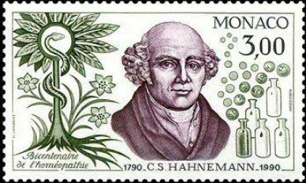
For two centuries, it has proved simple to apply and perfectly effective in most cases.
Complexistic homeopathy is a method that simplifies Hahnemanian practice :
- each complex containing the remedies that may cover the case,
- or those whose synergy will enhance the therapeutic effect.

Slide 3

But in the 21 st century, practitioners are confronted with new problems, induced by the reckless taking of chemical remedies:
Defective cases
few useful symptoms
(BNS is interesting in prevention: avoids additional explorations and many therapeutic essays)
Blurred cases
too many symptoms, complex pathologies, previous heavy treatments
Resistant cases
after treatments which seemed nevertheless indicated
In these numerous cases the BNS24, a homeopathic biological examination, becomes indispensable

Slide 4
A simple but complete exam
How do we do that ?
Reactivity Tests → Serum Reactions in living conditions
Unique Technic / Different from dry chemistry
A simple examination
(few parameters)
Sufficiently globalizing value
to highlight main dysfunctions observed in the clinic

Slide 5
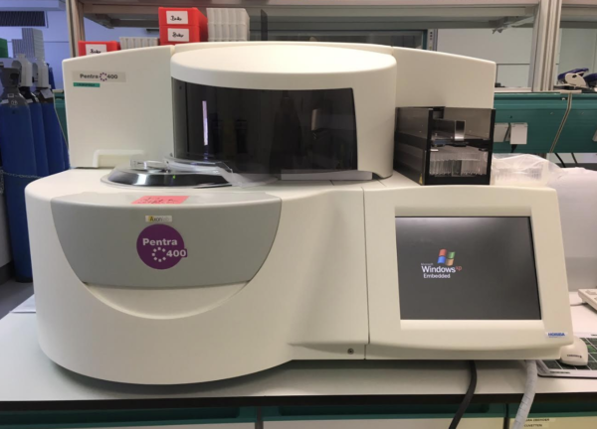
Via a modern spectrophotometer automat of humid chemistry

Slide 6
To be ideal, the BNS24 has to answers the five main questions of the practitioner:
WHERE ? → the levels of the organic regulations
HOW ? → Protidogramme (inflammatory state)
WHY ?→ Euglobulines (Exo stress)
WHEN ?→ Coefficient of homeostasy
= level of stability of the internal environment
WITH WHAT ? → A sample group of biological and homeopathic remedies for the optimal effect of regulation.

Slide 7
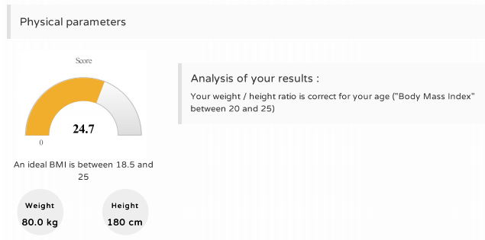
First of all : clinical data !

Slide 8
Serum situation: quantitative and qualitative data
This method is based on a triple approach:
A - An assessment of the inflammatory or deficient serum situation
B - Various types and levels of oxydative stress
C - Homeopathic remedies tested in the patient’s serum that will guide the practitioner towards a particular constitution and / or a similimum remedy
The data are expressed in standard deviations, a method that makes possible objective comparison betwen values ​​of different nature.

Slide 9
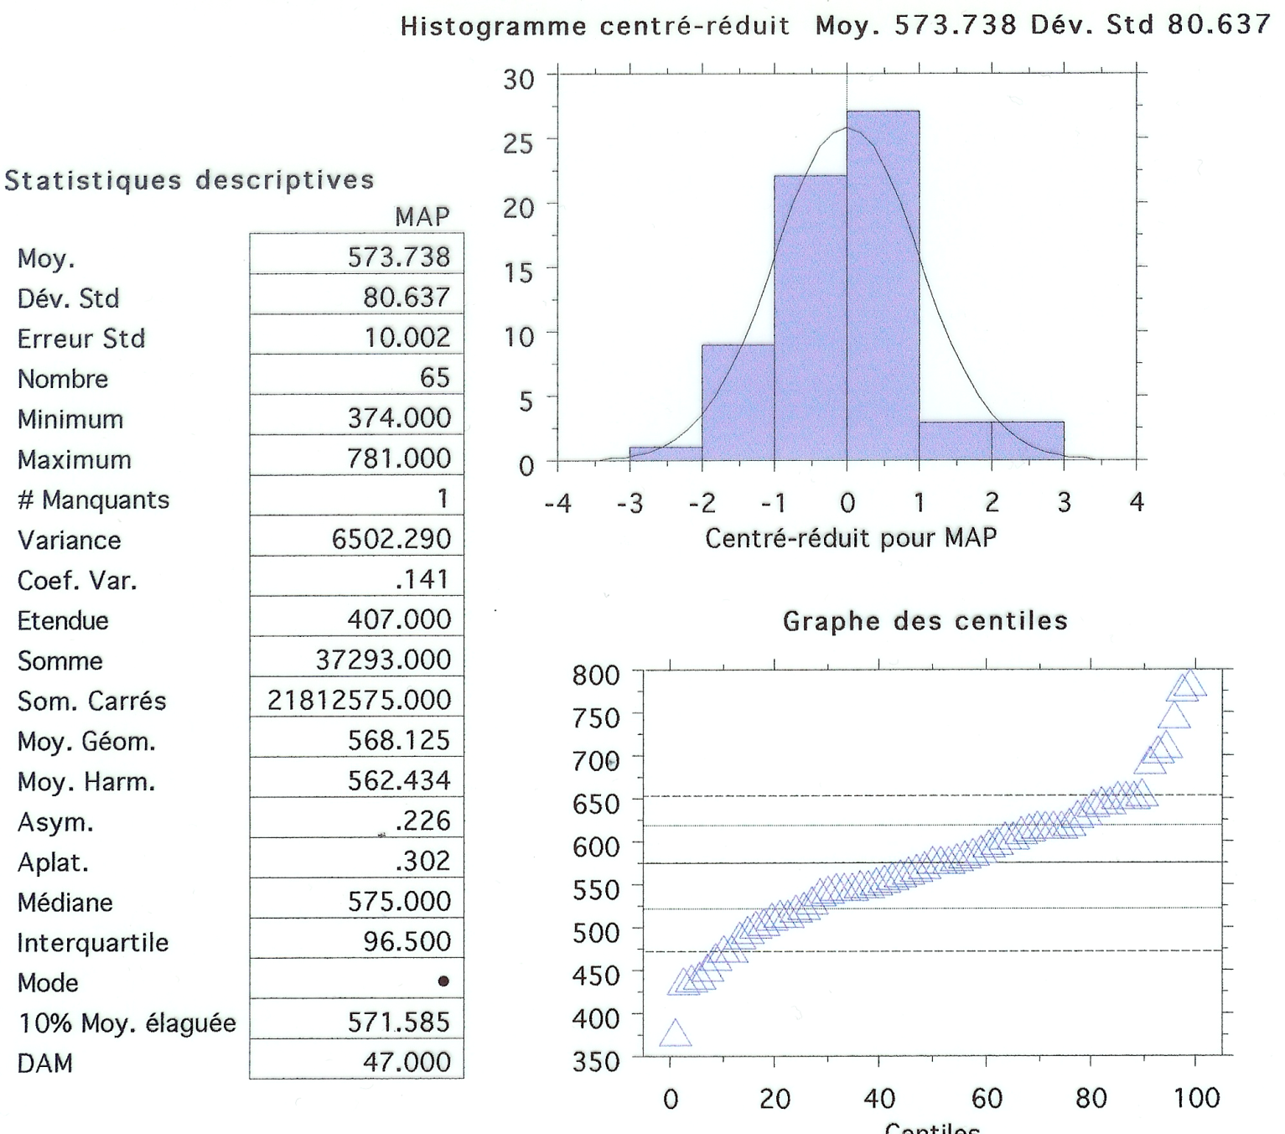
Linearity of responses and gaussian repartition

Slide 10
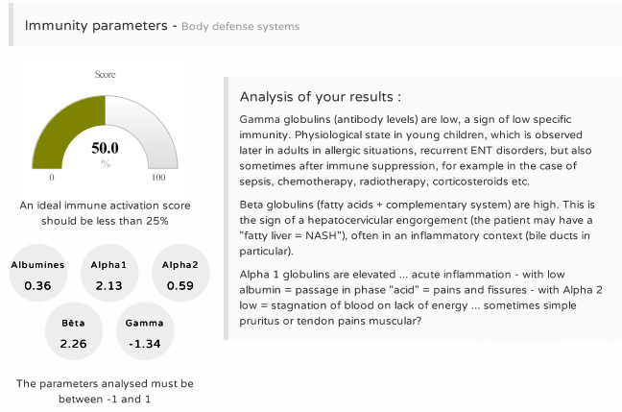
The protidogram

Slide 11
A - Serum situation: quantitative data =
The protidogram
The protidogram offers us, through classical values, crucial informations:
Hyper Albumines : Cortisol secretion, under stress
Hypo Albumines : Lack of tissular water, dryness by hormonal dysfonction = organic suffering
Hyper Alpha 1+2 : Macrocytary inflammation
Hypo Alpha 1 : Anemic tendency
Hypo Alpha 2 : Lack of energy
Hyper Beta + Gamma : Lymphocytary inflammation
Hypo Beta + Gamma : Allergic constitution

Slide 12
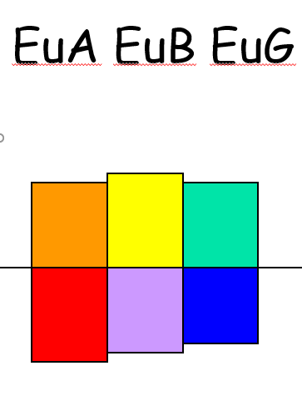
B - Euglobulins = modelling the « exogenous »
Cold : trauma / coldness
Heat : infection / pruritus
Drought : stiffness and pain
Humidity : allergies/oedema
Wind : fears / intoxication
Fire : burns / hight fever

Slide 13
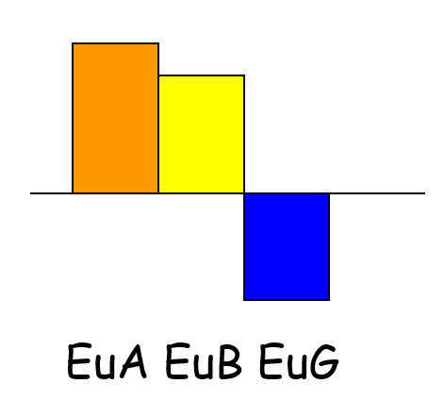
Modelling the « exogenous »
Euglobulines (biological tests at saturation) shows the importance of each of the stresses applied on the biological system :
Example :
hyper Eu Alpha + Eu Bêta with hypo Eu gamma
=
Fire + Wind and Dryness
→ « Chrong-Feng » in TCM … Stroke!

Slide 14
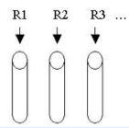
C - The serum reactivity test : a scientific approach to homeopathy?
G.R. HENSHAW (MD), american homeopath, from 1930, had the idea to try in vitro, on the plasma of his patients, dilutions of selected remedies, specific stresses directly tested on the serum colloid.
R1 R2 R3 … Remedy to be tested
Patient’s serum
If floculation = positive reaction

Slide 15
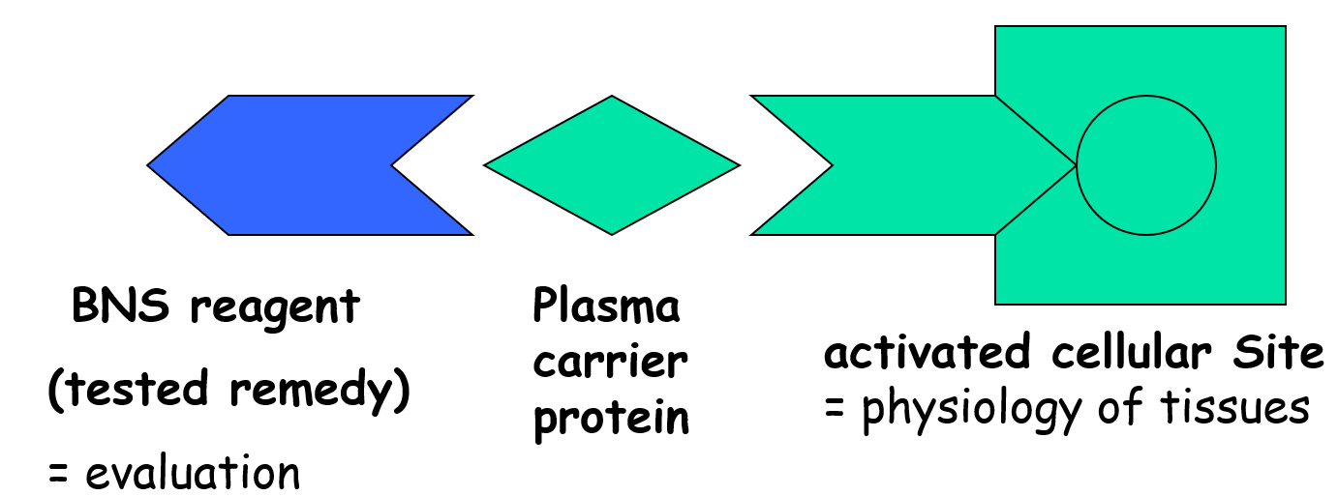
The “Serum remedy tests”: a fonctionnal approach
ions exchange = metabolic and immunizing activity

Slide 16
The «Serum remedy tests» a fonctionnal approach
In this functional approach, the interest is not on the molecules,
but rather the reaction of the "sites” with a certain type of ion (or salts)
This is our first postulate
It exist receiving sites on every tissues (although only a few have been, to this day, given prominence : pump with sodium, calcium, insulin …).
And our reagents have given prominence to the plasmatic activators of these sites.

Slide 17
A biological and computerized tool to quantify a systematic approach
Henshaw notices that the more the flocculation in-vitro, the bigger the effect of the remedy in-vivo !
From there, he kept experimenting for thirty years and tested with surprising results, in a total general indifference (in spite of diverse publications), more than 2000 remedies and numerous physiological substances (amino acids, fatty acids, vitamins).
In the BNS, the higher the flocculation rate, the more the patient has symptoms of the remedy, the lower it is, the older or the more chronic.

Slide 18
History of a systematic approach : the dynamics of the phenomenon
BNS24 is a method which proposes a stable biological image (the BNS moves little in 6 months, except evolutionary pathology) in the absence of specific treatment).
It remained to answer the question: “Is it serious doctor ?“
Numerous works tried to codify the dynamics of the events.
Let’s take a look at the organic polarities

Slide 19
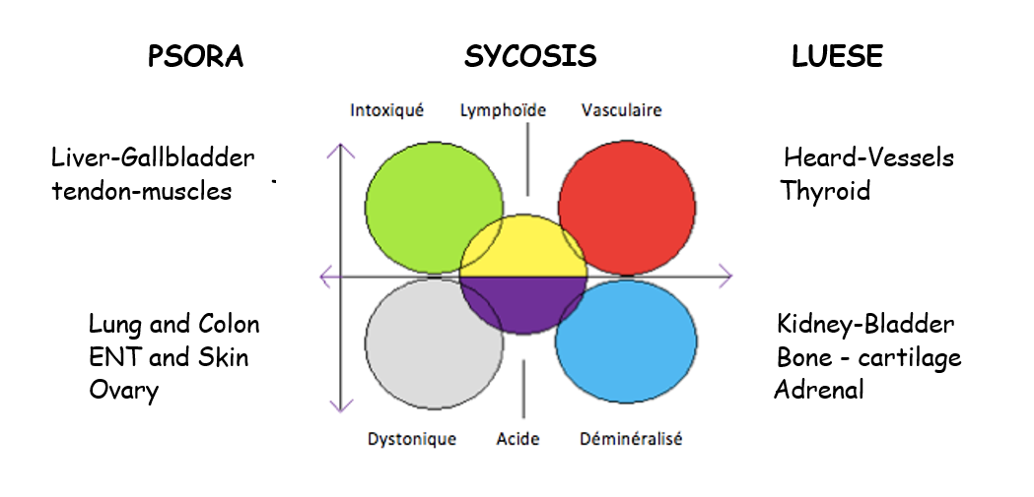
In his second book « Chronic diseases", S. Hahnemann, based on the hippocratic model, proposes a classification of diseases.

Slide 20
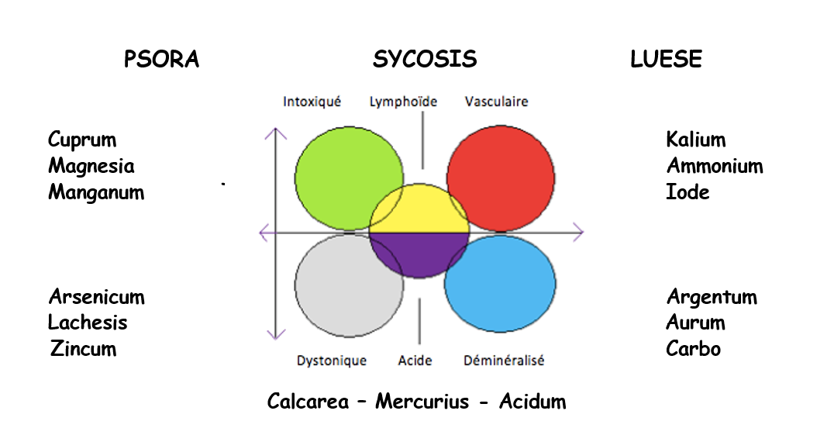
In his second book « Chronic diseases", S. Hahnemann, based on the hippocratic model, proposes a classification of remedies

Slide 21
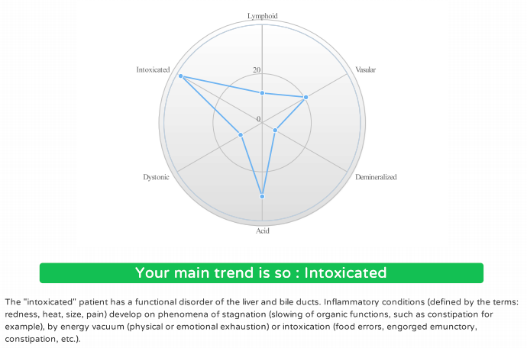

Slide 22
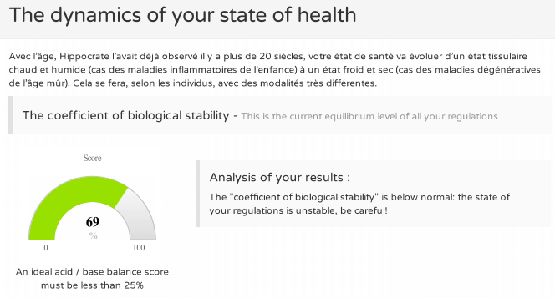
History of a systematic approach :
After the « how », the « when » ?

Slide 23
History of a systematic approach :
After the « how », the « when » ?
We also use two calculated parameters:
* A “Coefficient of homeostasis" sum of the observed abnormalities, in % of the maximal theoretical abnormality) which serves for estimating the instability of the internal regulations, thus risk growing of passage from a pathologic phase to the next one.
* A “Vascular Coefficient of suffering" which integrates the various parameters facilitating of the arteriosclerosis and indicate any exceeding speed in the degradation of the vascular bed.

Slide 24
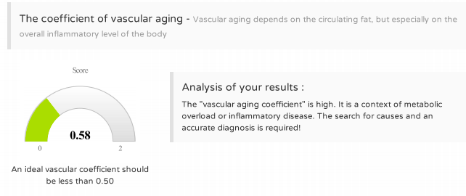
History of a systematic approach :
After the « how », the « when » ?

Slide 25

A systemic approach in medicine, biology and therapy ! (1)
Besides, it is possible to realize databases of the profiles of action of every remedy on the parameters of the BNS, chosen as landmarks.
Profile 1 + (6 weeks of the remedy to be tested) = profile 2 Biological effects of this remedy = Profile 2 – Profile 1

Slide 26
A systemic approach in medicine, biology and therapy (2)
Every new patient has his tests done and a remedy is proposed, the calculation being made according to the method of the traits, between the biological profile of the patient and those of the profiles of action of remedies susceptible to be used.
Our second postulate is therapeutic: if we manage to normalize his profile, the patient will feel better

Slide 27
A systemic approach in medicine, biology and therapy (3)
The effect of the remedy chosen aims at normalizing the profile of the patient. It corrects the various dysfunctions underlying the observed clinical symptoms and sometimes allows to obtain a remarkable effect.
But we are aware that we are ignoring the mechanisms according to which this therapeutic work is done (actions on stem cells, ionic streams, enzymatic ways, metabolic or immunizing balances) ?!

Slide 28
A systemic approach in medicine, biology and therapy (4)
This experimental approach has been widely completed in Europe since the 1970s.
Breakthroughs were realized : the move from the “reference rabbits" to a “human therapeutic reference" (in fact not so different) and the progressive realization of more than 120 000 patient’s profiles, thanks to the hundred of MD’s and veterinarians users.

Slide 29
A « Top-down » approch
The BNS24 - (biological profile “solution oriented") appreciate the metabolic and immunological balances of every patient, thus authorizing an evaluation of the risk, and a choice of specific remedies according to the serological dysfonctions put in evidence (and not in the nosological diagnosis, and here we are - naturally - blamed).
Obviously, nothing will replace the specific analyses of a particular nosological diagnosis, as for instance the dosage of the glycemia for the diabetes, uric acid for gout etc…

Slide 30
Interest and limits
" The most interesting things will come from a cunning balance between these two additional approaches, because the approach " Top down " (synthetical) allows to conceive effectively the organization of a space (biological - in our case).
In every place of this space, we can then use for more details the approach " Bottum up " (analytical). More generally, it is essential to have the capacity of lean between both scales."
Armand AJDARI (Laboratoire de physico-chimie théorique de l'école supérieure de physique et de chimie industrielle de Paris).

Slide 31
Interest
Numerous medical applications can be envisaged for the BNS, beginning with the redefining of certain nosological frames, the objectification of the real effects of existing medicines or new substances to be estimated.
The use of plants (rich in vitamins, essential fatty acids, phythormones and antioxidants, in ideal ratios), constitutes a simple, physiological and cheap medical treatment. The practitioner can nevertheless play on the concentrations, according to the expected effect.
These plants in low dilutions are a perfect biological support for a homeopathic treatment that can then develop all its power …

Slide 32
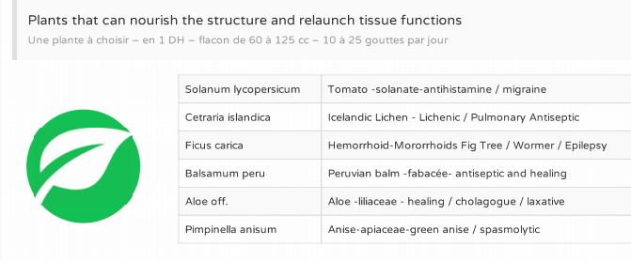
Therapy proposed

Slide 33
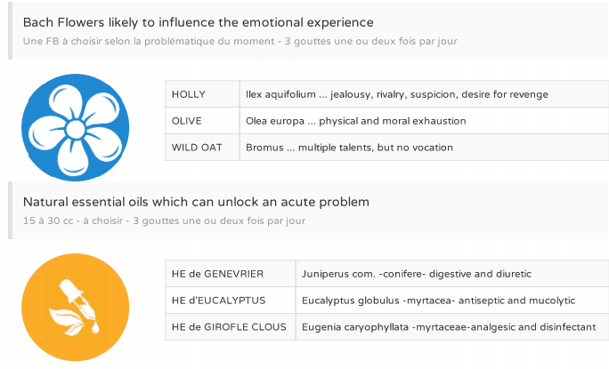
Therapy proposed (BFR & EH)

Slide 34
Therapy proposed
The BNS24 method realizes a treatment of complex organic sets by vegetal/homeopatic complex
Only a computer is capable of integrating the biological and therapeutic values to provide significant results !
The therapeutic headways were considerable, revealing the "magnificent" effect of certain natural remedies, as dyes of Calendula in the multiple sclerosis, Brassica in the fibromyalgia, or Vanilla in the rheumatoid polyarthritis, Oenothera in the neuro-algo-dystrophy …

Slide 35
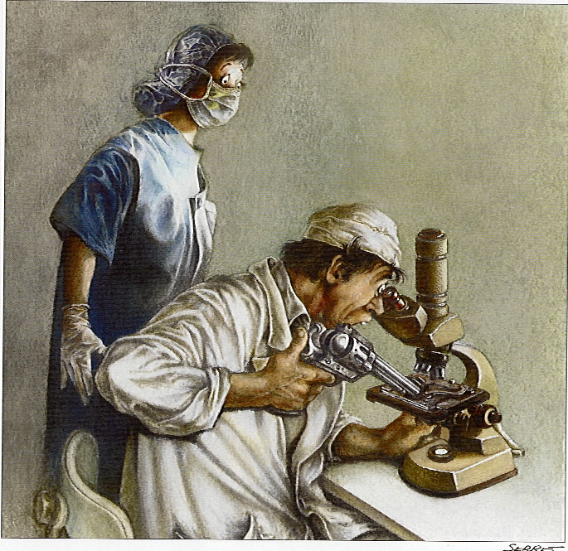
General remarks
Such a regulating approach allows, in more of 2/3 of the medical cases of a city clientele, for remarkable symptomatic improvement, after the third week.
But the BNS24 method, as other methods of biological exploration, has natural limits. We can observe difficulties:

Slide 36
Limits not to underestimate
Biological
the turbidimetry shows itself perfectly reproducible, but diverges beyond certain limits. It is the case for the big hyperlipemias or the monoclonal gammapathies
Clinical
certain affections have few markers at the serical level. It is the case for affections situated behind the meningeal barrier and certain disorders of the cellular lineages of the blood,
Therapeutic
serious or evolutionary affections are little influenced by the physiological treatments proposed by the BNS. However, in these "heavy" cases, even if the disease follows its course, the improvement of the comfort of life of the patient is noticed.

Slide 37
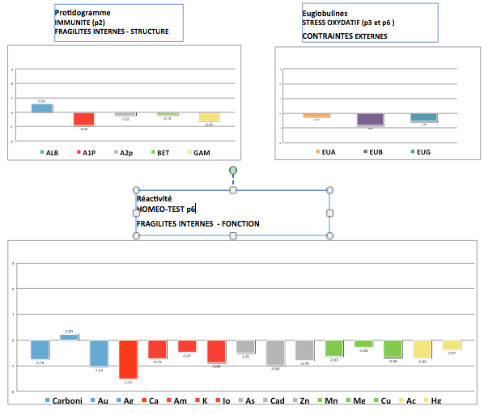
The « allergic » BNS24 hypostructure + hypofonction
Mrs C.. 35 years, suffer from asthma
since her adolescence (tested positive for cats, dogs, horses + candida)
All the efforts of desensitization are vain !
At the age of 3, she had eczema and also suffered from hay fever …
BNS24 (all hypo) =
Curcuma xanth. 1 DH + Zincum sulfur. 4 DH

Slide 38
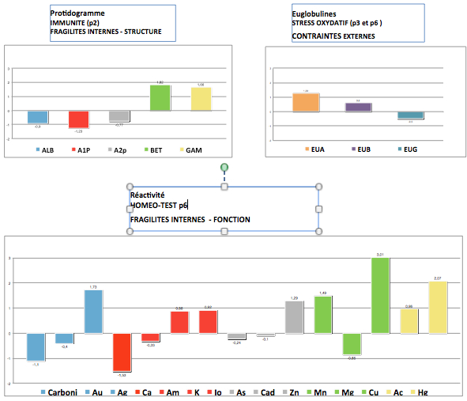
50-year-old lady, thin, weakened and hypotense, presenting systematic Sclerodermia
Hypo Albumines (water) et Alpha 1 (blood)
Hyper Bêta (complément) + Gamma (antibodies) = « Auto-immune disease »
Hyper EuA (« fire ») on hypo EuG (« dryness »)
Cuprum and Mercurius

Slide 39
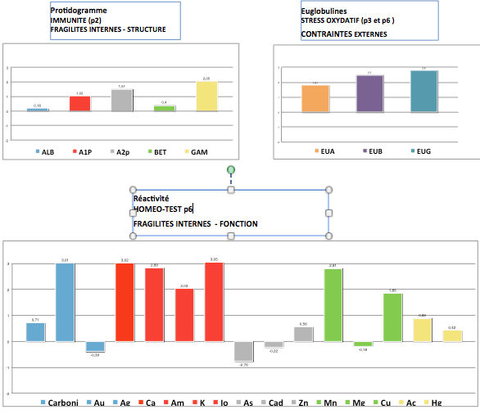
Mrs G. 54 years old
Mild renal insufficiency
Clinically well …
moderate overweight and HTA
Biologicaly well…
except Urea to 9,5 mmol./l et Creatinine to 122
In fact, monstrous hépato-renal polykystose !
Spartium junceum (mn) 1 DH

Slide 40
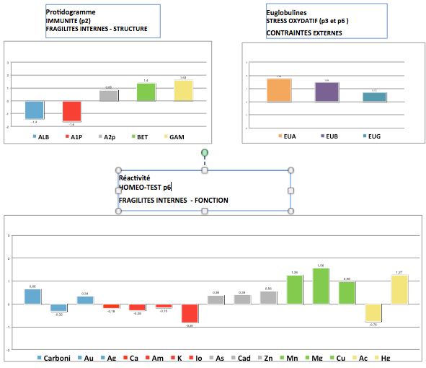
Giant rash
Mr. Ram.. suffers from one giant rash with Quincke oedema since his mumps (1995). Tested positive for grass, nothing improves him …
By emptying the lymphoïd system (Gamma), by putting some water in the kidney (Alb.), limiting the oxydatif stress …
everything went gradually back to order with :
Erodium cicutarium (K)

Slide 41
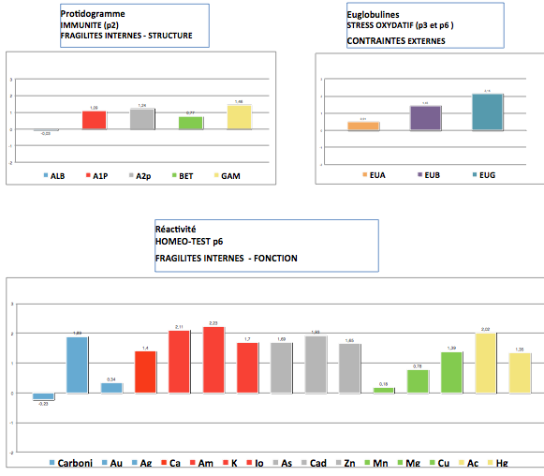
Pensioned doctor, HTA + two infarcts, family hypercholesterol level, gout, but normal weight
Under betaBloker,
IEC, zyloric and statin
(cholesterol is normal!).
He is coming
for insomnia !

Slide 42
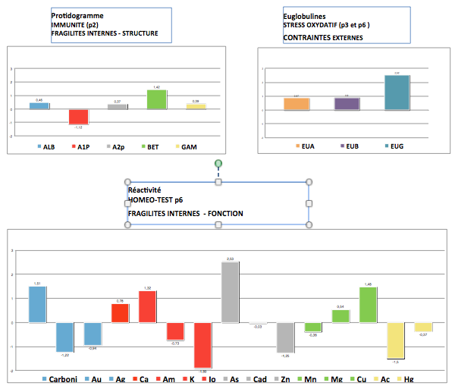
Lady with algo-neuro-dystrophy
But all normal classical data !
Arsenicum album has the most important serical reaction … and had an astonishing therapeutic effect +++

Slide 43
What is the interest for you ?
Our test help us for the diagnostic and the treatment of your patients
Can give a confirmation and demonstrate the improvement of the health of our patients
Justify & advice the most accurate homeopathic treatment
Scientific & biological support for your practice

Slide 44
How can you collaborate with us & propose the BNS to your prescribers & patients ?
You collect 3 cc of exuded serum (or spin-dried) in a dry tube with the clinical index form filled with the help of the practitioner (on paper or on the web platform)
You send by express mail (Fedex) the batch of serum with unique serial code stickers delivered by us
You collect the payment from the patients
After few days : the web platform will send a message to the prescribers and the patients to consult the result of the analysis
Is it possible to do it locally ?
The serum must be analysed in batch (minimum 20 serums) with a specific machine
Possible to do it locally with the accurate machine which will communicate directly with our IT system

Slide 45
And Partnership ?
FFMI and MyBioBox SA have a few teachers-researchers and a little more than a hundred of user doctors
We are in search of scientific collaboration to:
Optimize the patients data bank, verify statistically the dynamical links between clinical and biological data,
Raise any relevant question on this method and publish our results and findings.
→ In order to develop continously a unique tool for homeopathic doctors

Slide 46
Bibliography :
“Matière médicale thérapeutique” P. Kollitsch (Masson, 1955)
“L’homotoxicologie” H.H. Reckeweg (Aurelia-Verlag, 1955)
“The serum reactivity test” G. Henshaw (Exposition press 1980)
“La gemmothérapie” Pol Henry (Belgique, 1983)
“Exploitation clinique des profils protéiques” Giraudet, Coudon et Postel (Technicon 1990)
“Le système de la régulation de base” A. Pischinger (Haug 1994)
"La méthode du CEIA ou l'analyse du vivant" E. Reymond (ed. Satas, 1999)
“Diagnostic précoce par profil protéique” E. Petricoin et coll. (Lancet 2002, 359:572-577)
“Why stock markets crash“ D. Sornette (PRINCETON UNIVERSITY PRESS, 2003)
“What medicine for tomorrow ?” Françoise et J.Y. Henry (IMH, 2012)

Slide 47
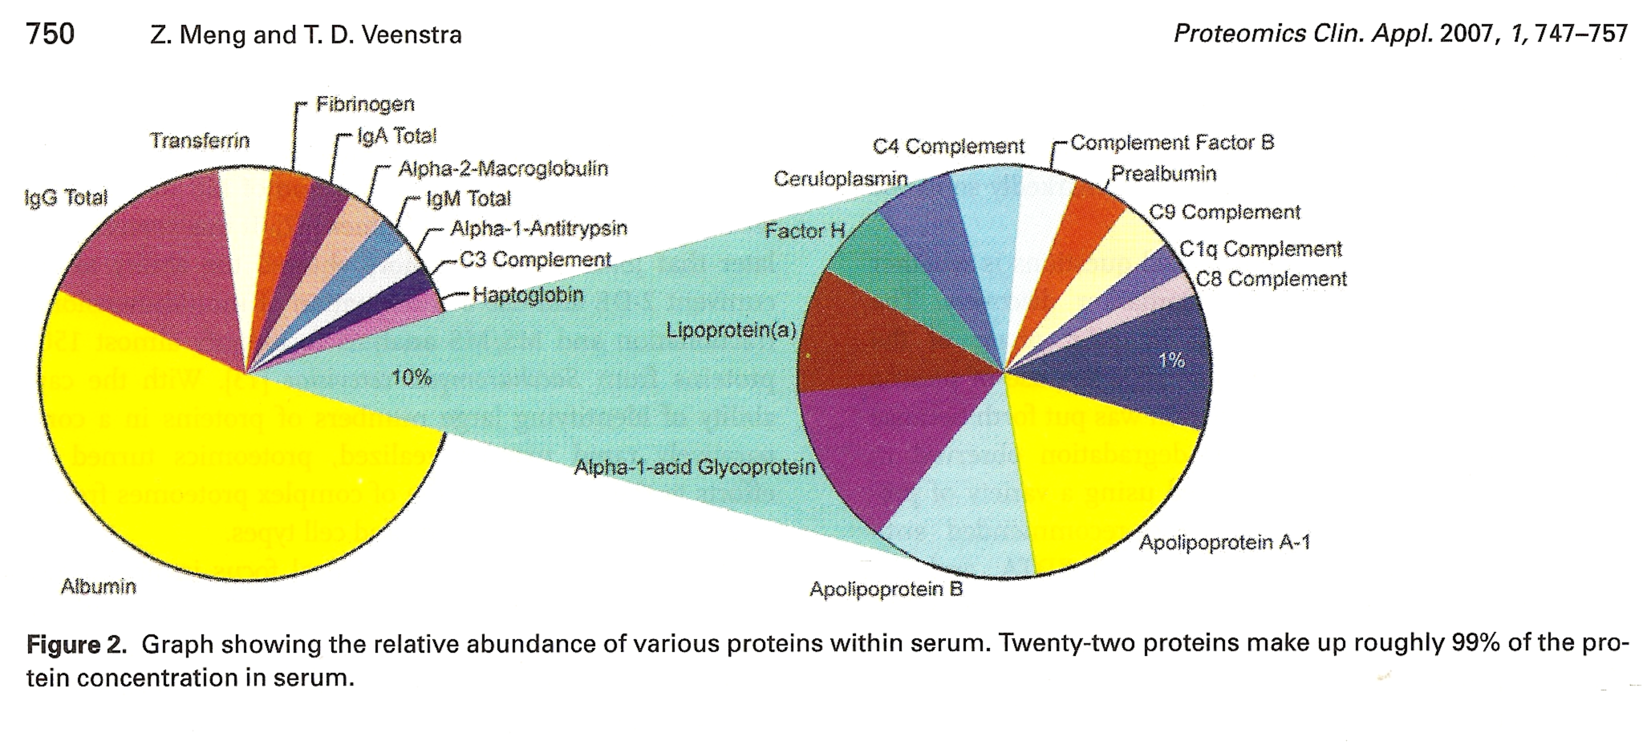
The classic approach in biology: we quantify carrier proteins

Slide 48
History of a systematic approach :
After the « how », the « when » ?
We observed with interest Didier SORNETTE's works (EPFZ, specialist of the physics of the rare events) on the phenomena of break (log periodic power law equation).
He describes a state of imbalance growing under the influence of diverse constraints:
F (t) = - [A + B (Tc-T)^m
(1 + C*cosinus (w de logarithme de (Tc-T)))]
NB. Formula in which the coefficient C multiplies the cosine so as to modulate the amplitude of the oscillations.

Slide 49
History of a systematic approach :
After the « how », the « when » ? (3)
Its shape evokes the "curve in staircase" which models the levels of degradation of the homeostasis, as well as the increase of amplitude of the oscillations, the phenomenon precursor of a break which is going to result in a fundamental change of regime of functioning (at a lower level).
What is surprising, is that the formula predicts that at the end of 5 to 6 breaks (change of levels), all the systems are definitively going to disrupt (same at the level of the human pathology) !

Slide 50
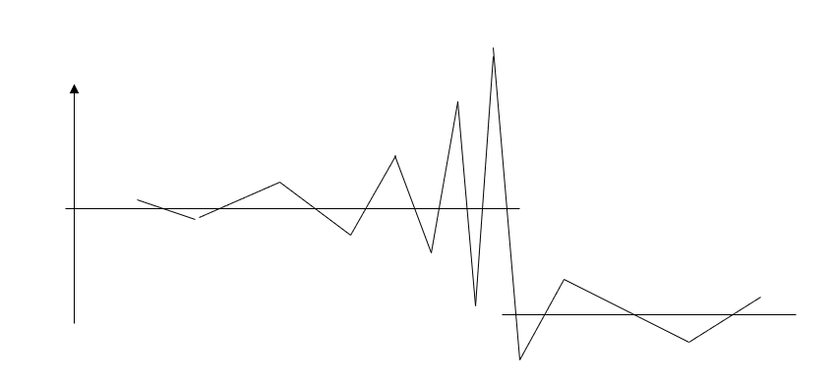
History of a systematic approach …
After the « how », the « when » ? (4)
Waiting to improve predictability by a multifractal cascade model, applying the formula of D. Sornette to our system through the study of big series of patients (work in progress)

